Slide 1
Import data from
web
Import data from
web

Slide 2
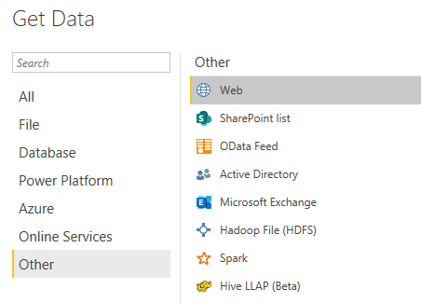
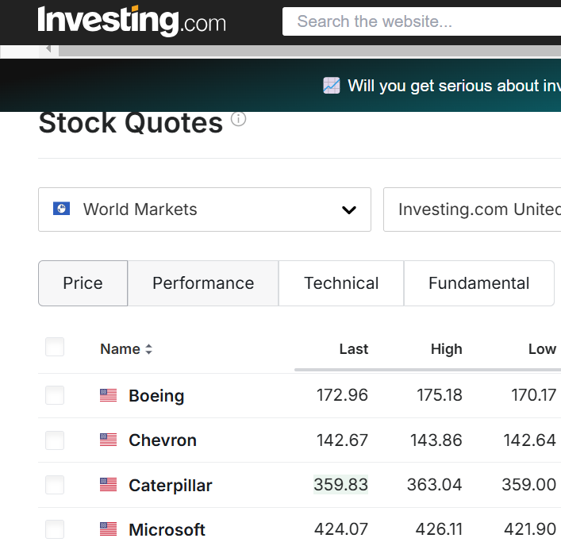
Importing data from web
Select Web as data source
Navigate to https://www.investing.com/equities and take a look

Slide 3
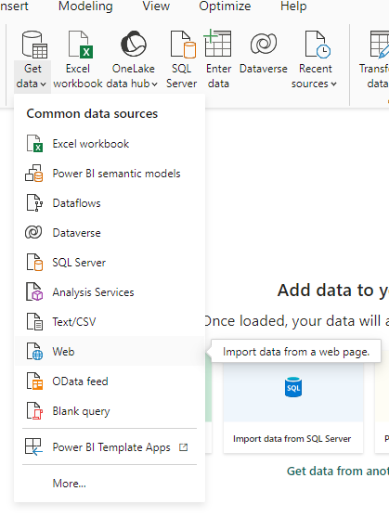
Importing data from web
Select web source
1
2

Slide 4
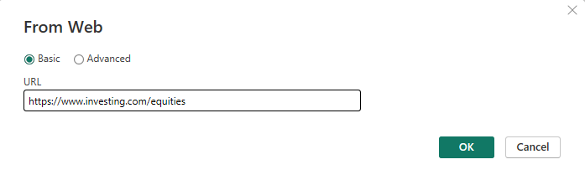
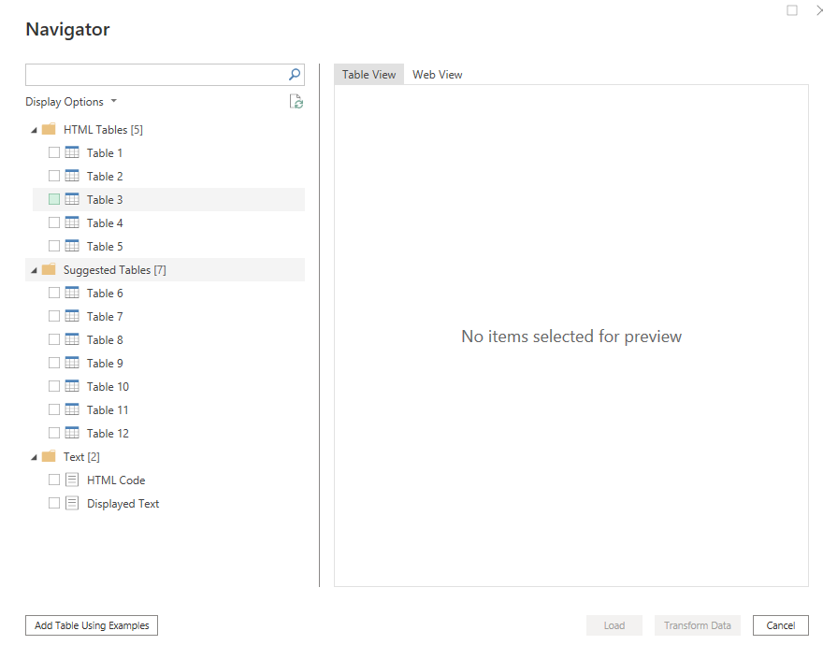
Importing data from web
In the URL field, enter the link, then click next and choose Anonymous authentication, then click Connect
Try to navigate between the two tabs Table View and Web View

Slide 5
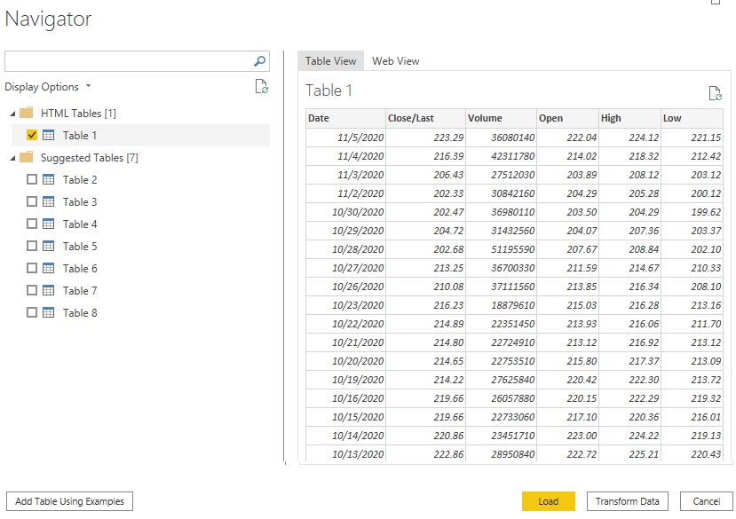
Importing data from web
Try to navigate between the two tabs Table View and Web View

Slide 6
Thank you
Thank you

